Slide 1
Mastering NT Greek
11. Pronoun Paradise:
Demonstrative, Relative, Reflexive, and Reciprocal
By Ted Hildebrandt © 2003
Baker Academic

Slide 2
PAI Verb Paradigm Rap
λύω λύομεν
λύεις λύετε
λύει λύουσι(ν)

Slide 3
2-1-2 Paradigms - Chant this
2 1 2
λόγος γραφή ἱερόν
λόγου γραφῆς ἱεροῦ
λόγῳ γραφῇ ἱερῷ
λόγον γραφήν ἱερόν
λόγοι γραφαί ἱερά
λόγων γραφῶν ἱερῶν
λόγοις γραφαῖς ἱεροῖς
λόγους γραφάς ἱερά

Slide 4
The "is" verb PAI -- εἰμί
εἰμί ἐσμέν εἶ ἐστέ ἐστί(ν) εἰσί(ν)

Slide 5
Person Personal Pronoun Chant
Singular Plural
Nom. ἐγώ σύ ἡμεῖς
Gen. μου σου ἡμῶν Dat. μοι σοι ἡμῖν Acc. με σε ἡμάς
αὐτός, αὐτη, αὐτό (he, she, it)

Slide 6
Present Middle/Passive Indicative
λύομαι, -ομεθα -ῃ, -εσθε -εται, -ονται
I am loosed/am being loosed
I loose myself/am loosing [for myself]

Slide 7
Shape of the Future in Greek
λύσω λύσομεν I will loose We will loose
λύσεις λύσετε You will loose You all will loose
λύσει λύσουσι(ν) S/he/it will loose They will loose
Chant this one

Slide 8
Future Middle Paradigm
λύσομαι -όμεθα -ῃ -εσθε -εται -ονται
I will loose (for myself) We will loose (for ourselves) …

Slide 9
Rapping the Lord’s Prayer
Πάτερ ἡμῶν ὁ ἐν τοῖς οὐρανοῖς father our the one in heaven
ἁγιασθήτω τὸ ὄνομά σου make holy name your
ἐλθέτω ἡ βασιλεία σου let come kingdom your
γενηθήτω τὸ θέλημά σου, let be will your

Slide 10
Four Types of Pronouns
Demonstratives: this / that pointers
Adjectival: This day is beautiful.
Pronominal: This is the beginning.
Relatives: who, whom, which
The one who enjoys Greek enjoys life.
The keys which were lost in the river are ...
Reflexive: He hid himself in the rubble.
Reciprocal: They appreciate one another.

Slide 11
Demonstratives: this and that
Stand alone as a pronoun: “that one”
Modify a noun as an adjective: the noun takes the definite article (e.g., this desk).
Form: Def. Art. + Noun + Demonstrative (no article) -- this is the opposite of the attributive adjective that takes an article.

Slide 12
That paradigm: e]kei?noj
Singular: that
2 1 2
Masc Fem Neut
Nom. ἐκεῖνος ἐκείνη ἐκεῖνο
Gen. ἐκείνου ἐκείνης ἐκείνου Dat. ἐκείνῳ ἐκείνῃ ἐκείνῳ Acc. ἐκεῖνον ἐκείνην ἐκεῖνο

Slide 13
That paradigm: e]kei?noj
Plural: those
2 1 2
Masc Fem Neut
Nom. ἐκεῖνοι ἐκεῖναι ἐκεῖνα
Gen. ἐκείνων ἐκείνων ἐκείνων Dat. ἐκείνοις ἐκείναις ἐκείνοις Acc. ἐκείνους ἐκείνας ἐκεῖνα

Slide 14
ἐκεῖνος “that”
ἐκεῖνος ἐκίνη ἐκεῖνο ἐκείνου ἐκείνης ἐκείνου ἐκείνῳ ἐκείνῃ ἐκείνῳ ἐκεῖνον ἐκείνην ἐκεῖνο
ἐκεῖνοι ἐκεῖναι ἐκεῖνα ἐκείνων ἐκείνων ἐκείνων ἐκείνοις ἐκείναις ἐκείνοις ἐκείνους ἐκείνας ἐκεῖνα

Slide 15
This paradigm: οὗτος
Singular: this
Masc Fem Neut
Nom. οὗτος αὕτη τοῦτο
Gen. τούτου ταύτης τούτου Dat. τούτῳ ταύτῃ τούτῳ Acc. τοῦτον ταύτην τοῦτο
α or η ending takes an αυ not ου

Slide 16
This paradigm: οὗτος
Plural: these
Masc Fem Neut
Nom. οὗτοι αὗται ταῦτα
Gen. τούτων τούτων τούτων Dat. τούτοις ταύταις τούτοις Acc. τούτους ταύτας ταύτα
α or η ending takes an αυ not ου

Slide 17
οὗτος “this”
οὗτος αὕτη τοῦτο τούτου ταύτης τούτου τούτῳ ταύτῃ τούτῳ τοῦτον ταύτην τοῦτο
οὗτοι αὗται ταῦτα τούτων τούτων τούτων τούτοις ταύταις τούτοις τούτους ταύτας ταῦτα

Slide 18
Relative Pronouns: ὅς, ἥ, ὅ
Singular: who/which Plural
M F N M F N
Nom. ὅς ἥ ὅ οἵ αἵ ἅ Gen. οὗ ἧς οὗ ὧν ὧν ὧν Dat. ᾧ ᾗ ᾧ οἷς αἷς οἷς Acc. ὅν ἥν ὅ οὕς ἅς ἅ

Slide 19
Translation Examples
καὶ ὃς οὐ λαμβάνει
and who did not receive
καὶ τῷ λόγῳ ὃν εἶπεν ὁ Ἰησοῦς
and to the word which Jesus spoke

Slide 20
Reflexive Pronouns
Nominative uses the personal pronouns: ἐγώ, σύ, αὐτός
Gen., Dat., and Acc. have special ones

Slide 21
First Person Reflexive -- myself
Masc Fem
Gen. sg. ἐμαυτοῦ ἐμαυτῆς Dat. sg. ἐμαυτῷ ἐμαυτῇ Acc. sg. ἐμαυτόν ἐμαυτήν
Gen. pl. ἑαυτῶν ἑαυτῶν Dat. pl ἑαυτοῖς ἑαυταῖς Acc. pl ἑαυτούς ἑαυτάς

Slide 22
Second Person Reflexive -- yourself
Masc Fem
Gen. sg. σεαυτοῦ σεαυτῆς Dat. sg. σεαυτῷ σεαυτῇ Acc. sg. σεαυτόν σεαυτήν
Gen. pl. ἑαυτῶν ἑαυτῶν Dat.pl. ἑαυτοῖς ἑαυταῖς Acc. pl. ἑαυτούς ἑαυτάς

Slide 23
Third Person Reflexive -- him/her/itself
Masc Fem Neut
Gen. sg. ἑαυτοῦ ἑαυτῆς ἑαυτοῦ Dat. sg. ἑαυτῷ ἑαυτῇ ἑαυτῷ Acc. sg. ἑαυτόν ἑαυτήν ἑαυτό
Gen. pl. ἑαυτῶν ἑαυτῶν ἑαυτῶν Dat. pl. ἑαυτοῖς ἑαυταῖς ἑαυτοῖς Acc. pl. ἑαυτούς ἑαυτάς ἑαυτά

Slide 24
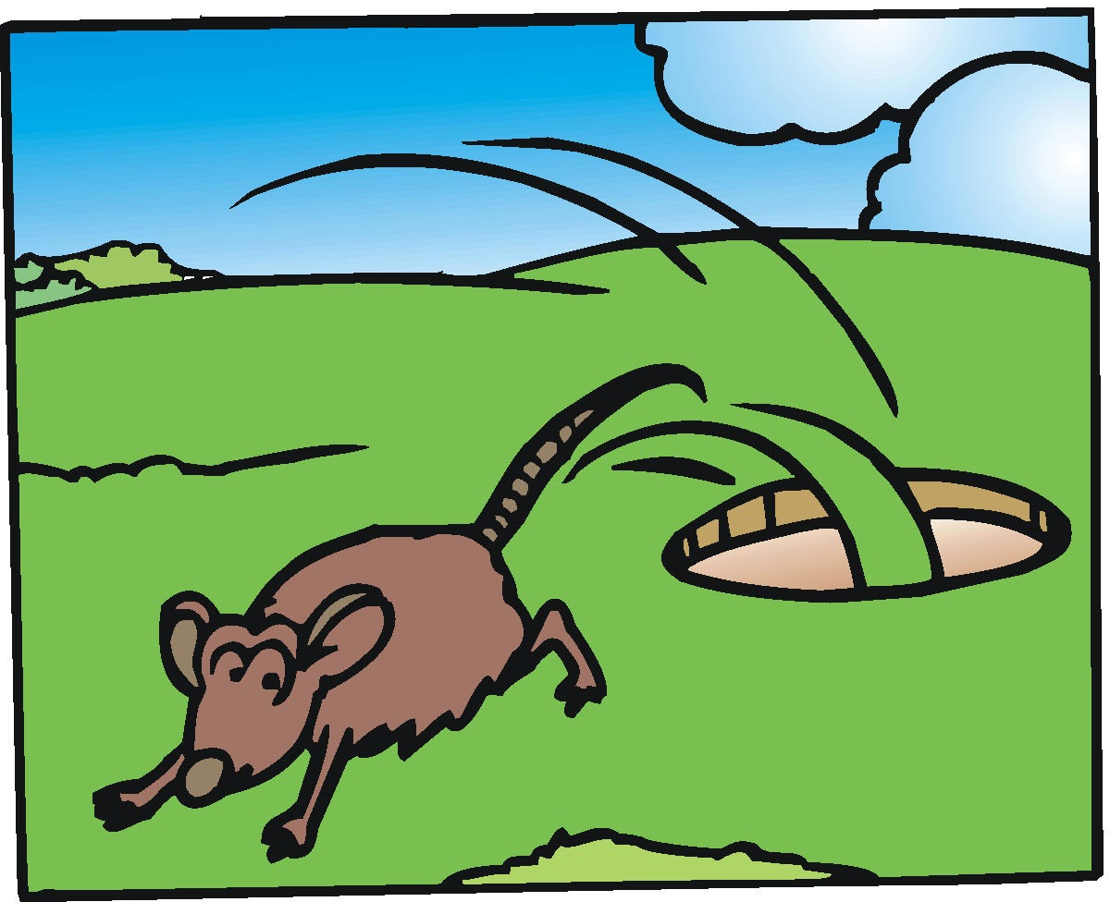
Chapter 11 Vocabulary
ἀπέρχομαι
I go away, leave

Slide 25
Chapter 11 Vocabulary
ἐκεῖνος
that

Slide 26
Chapter 11 Vocabulary
Ἰουδαῖος, -α, -ον
Jewish

Slide 27
Chapter 11 Vocabulary
καθώς
as, just as

Slide 28
Chapter 11 Vocabulary
ὅς, ἥ, ὅ
who, which

Slide 29
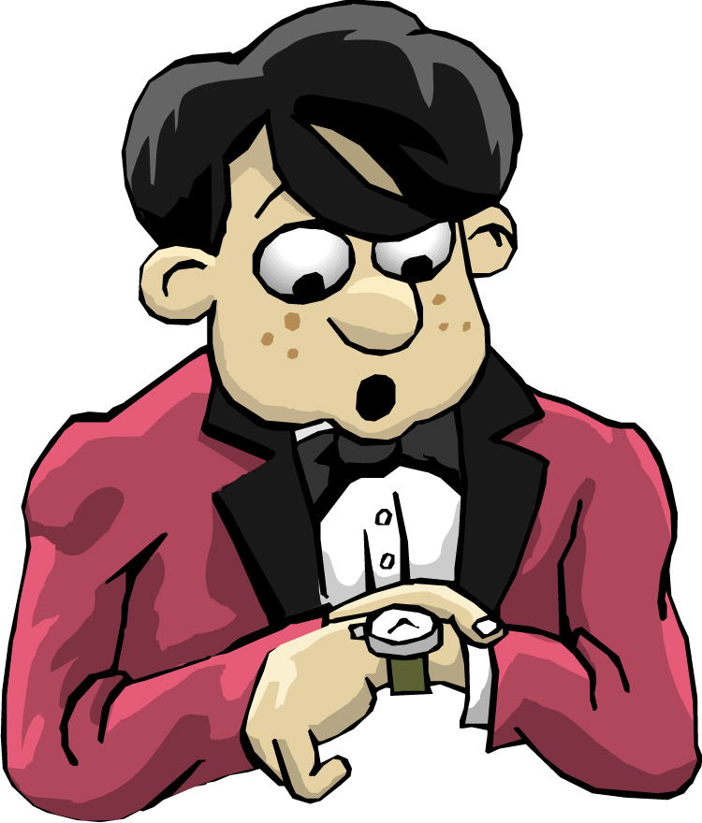
Vocabulary - Chapter 11
ὅταν
when

Slide 30
Chapter 11 Vocabulary
οὗτος, αὗτη, τοῦτο
this

Slide 31
Chapter 11 Vocabulary
πάλιν
again

Slide 32
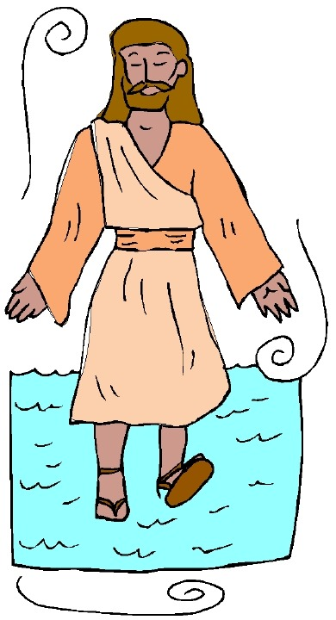
Chapter 11 Vocabulary
Πέτρος, -ου, ὁ
Peter

Slide 33
Chapter 11 Vocabulary
ὑπέρ
for, about (gen.)
above, beyond (acc.)

Slide 34
Demonstrative, Relative and Reflexiv Pronouns
ἐκεῖνος, ἐκείνη, ἐκεῖνο = that
οὗτος, αὕτη, τοῦτο τούτου, ταύτης, τούτου = this
ὅς ἥ ὅ = Relative (who, which) οὗ ἧς οὗ
ἐμαυτοῦ, σεαυτοῦ, ἑαυτοῦ: reflexive –myself, yourself, him/herself

Slide 35
Ch. 1 -- Vocabulary
angel, messenger
ἄγγελος, -ου, ὁ
verily, truly
ἀμήν
man, humankind
ἄνθρωπος, -ου, ὁ
I
ἐγώ
God
θεός, -οῦ, ὁ

Slide 36
Ch. 1 -- Vocabulary
and, also, even
καί
heart
καρδία, -ας, ἡ
I say
λέγω
prophet
προφήτης, -ου, ὁ
Christ, Messiah
Χριστός, -οῦ, ὁ

Slide 37
Ch. 2 -- Vocabulary
brother
ἀδελφός, -οῦ, ὁ
I hear, obey
ἀκούω
glory, fame
δόξα, -ης, ἡ
I have
ἔχω
world
κόσμος, -ου, ὁ

Slide 38
Ch. 2 -- Vocabulary
Lord, sir
κύριος, -ου, ὁ
word
λόγος, -ου, ὁ
Peter
Πἑτρος, -ου, ὁ
son
υἱός, -οῦ, ὁ
Pharisee
Φαρισαῖος, -ου, ὁ

Slide 39
Ch. 3 -- Vocabulary
but, yet
ἀλλἀ
apostle, sent one
ἀπόστολος, -ου, ὁ
I see
βλέπω
for, then
γάρ
I know
γινώσκω

Slide 40
Ch. 3 -- Vocabulary
Jesus
Ἰησοῦς, -οῦ, ὁ
I take, receive
λαμβάνω
I loose
λύω
heaven
οὐρανός, -οῦ, ὁ
I believe
πιστεύω

Slide 41
Ch. 4 -- Vocabulary
I love
ἀγαπάω
I write
γράφω
but, and
δέ
servant, slave
δοῦλος, -ου, ὁ
I find
εὑρίσκω

Slide 42
Ch. 4 -- Vocabulary
temple
ἱερόν, -οῦ, τό
People
λαός, -οῦ, ὁ
law
νόμος, -ου, ὁ
house
οἶκος, -ου, ὁ
as, about, how
ὡς

Slide 43
Ch. 5 -- Vocabulary
love
ἀγάπη, -ης, ἡ
truth
ἀλήθεια, -ας, ἡ
sin
ἁμαρτία, -ας, ἡ
kingdom
βασιλεία, -ας, ἡ
writing, Scripture
γραφή, -ῆς, ἡ

Slide 44
Ch. 5 -- Vocabulary
I raise up
ἐγείρω
assembly, church
ἐκκλησία, -ας, ἡ
work
ἔργον, -ου, τό
disciple
μαθητής, -οῦ, ὁ
Hour
ὥρα, -ας, ἡ

Slide 45
Chapter 6 Vocabulary
ἀπό (Gen.)
from
διά (Gen.)
through
διά (Acc.)
on account of
εἰς (Acc.)
into

Slide 46
Chapter 6 Vocabulary
ἐκ (Gen.)
out of, from
ἐν (Dat.)
in
ἐπί (Gen.)
on, over
ἐπί (Dat.)
on, at, against, on the basis of

Slide 47
Chapter 6 Vocabulary
ἐπί (Acc.)
on, to, toward, against
κατά (Gen.)
down, against
κατά (Acc.)
according to
μετά (Gen.)
with

Slide 48
Chapter 6 Vocabulary
μετά (Acc.)
after, behind
περί (Gen.)
about, concerning
περί (Acc.)
around, near
πρός (Acc.)
to

Slide 49
Vocabulary -- Ch. 7
good
ἀγαθός, -ή, -όν
Holy
ἅγιος, -α, -ον
righteous
δίκαιοις, -α, -ον

Slide 50
Vocabulary – Ch. 7
I am
εἰμί
Jewish, a Jew
Ἰουδαῖος, -α, -ον
Great
μέγας, μεγάλη, μέγα

Slide 51
Vocabulary -- Ch. 7
dead
νεκρός, -ά, -όν
no, not
οὐ, οὐκ, οὐχ
first
πρῶτος, -η, -ον
voice
φωνή, -ῆς, ἡ

Slide 52
Vocabulary Ch. 8
he/she/it
αὐτός, -ή, -ό
land, earth, region
γῆ, -ῆς, ἡ
I, we
ἐγώ, ἡμεῖς
day
ἡμέρα, -ας, ἡ
that, so that
ὅτι

Slide 53
Vocabulary Ch. 8
so, then, therefore
οὖν
crowd
ὄχλος, -ου, ὁ
from
παρά (with Gen.)
beside, with
παρά (with Dat.)
alongside, beside
παρά (with Acc.)

Slide 54
Vocabulary Ch. 8
you / you (pl)
σύ / ὑμεῖς
by, at the hands of
ὑπό (with Gen.)
under, below
ὑπό (with Acc.)

Slide 55
Vocabulary Ch. 9
I answer
ἀποκρίνομαι
I send
ἀποστέλλω
I throw
βάλλω
I become
γίνομαι
I come in
εἰσέρχομαι

Slide 56
Vocabulary Ch. 9
I go out
ἐξέρχομαι
I come/go
ἔρχομαι
I wish
θέλω
thus, so
οὕτως
I go
πορεύομαι

Slide 57
Vocabulary Ch. 10
life
ζωή, -ῆς, ἡ
death
θάνατος, -ου, ὁ
I judge
κρίνω
I remain
μένω
only, alone
μόνος, -η, -ον

Slide 58
Vocabulary Ch. 10
now
νῦν
and not, nor
οὐδέ
Paul
Παῦλος
I save
σῴζω
then
τότε

